Slide 1

PE32 Password
Kyungpook National University
Taekwan Yang (CSE GSWC, KERT)
ytk2128@gmail.com
https://github.com/ytk2128/pe32-password

Slide 2
Contents
Outline
Implementation
Conclusion

Slide 3
Outline

Slide 4
Outline
Project | PE32 Password
Description | Encrypting x32 executable files (.exe) to lock with the password
Programming Language | C++, x86 Assembly
Operating System | Windows 10 Pro x64
Goals | 1. Deeper understanding of Windows Internals (format of executable files and how operating system executes files) and SEED128 (symmetric encryption algorithm provided by Korea Internet & Security Agency) 2. Developing a sample project based on my library (for modifying windows executable files)

Slide 5
Outline – Process of Normal A
A.exe
Main function of A.exe
Double click
Execute

Slide 6
Outline – Encryption Process
A.exe
PE32 Password
1. Encrypt sections (code, data, resource)
2. Inject new main function and other functions
3. Saved as different file
Encrypted A.exe

Slide 7
Outline – Process of Encrypted A
Encrypted A.exe
Injected new main function
Double click
Check the password and Decrypt sections
Main function of A.exe
Jump to original main function
Execute

Slide 8
Implementation

Slide 9
Implementation – Normal Case
A.exe
Refer to PE Headers and allocate new memory
Get important addresses to refer to data section
PE Headers
Data section
Code section
Resource section
Operating System
Refer to data and code section
Prepare API addresses that A.exe would need for execution
Apply relocated memory addresses to code section

Slide 10
Implementation – Normal Case
A.exe
PE Headers
Data section
Code section
Resource section
Get entry point address
Operating System
Execute entry point

Slide 11
Implementation – Error Case
Encrypted A.exe
Refer to PE Headers and allocate new memory
Get important addresses to refer to data section
PE Headers
Encrypted Data section
Encrypted Code section
Encrypted Resource section
Injected new code
Operating System
Refer to data and code section
Prepare API addresses that A.exe would need for execution
Apply relocated memory addresses to code section

Slide 12
Implementation – Encrypted Case
Encrypted A.exe
Refer to PE Headers and allocate new memory
Get entry point address
PE Headers
Encrypted Data section
Encrypted Code section
Encrypted Resource section
Injected new code
Operating System
Execute entry point

Slide 13
Implementation – Encrypted Case
Encrypted A.exe
PE Headers
Encrypted Data section
Encrypted Code section
Encrypted Resource section
Injected new code
Operating System
Decrypt sections if the password is correct

Slide 14
Implementation – Encrypted Case
Encrypted A.exe
PE Headers
Data section
Code section
Resource section
Injected new code
Operating System
Decrypt sections if the password is correct
Get important addresses to refer to data section
Refer to data and code section
Prepare API addresses that A.exe would need for execution
Apply relocated memory addresses to code section

Slide 15
Implementation – Encrypted Case
Encrypted A.exe
PE Headers
Data section
Code section
Resource section
Injected new code
Operating System
Get original entry point address
Jump to original entry point

Slide 16
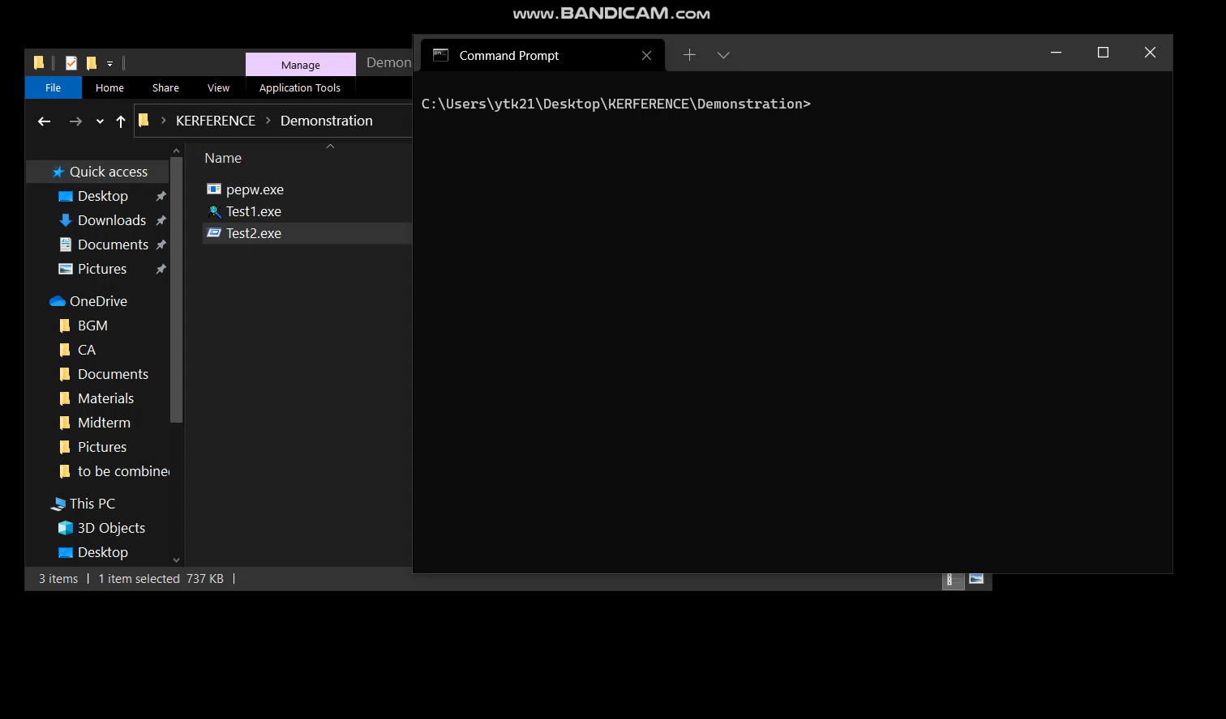
Implementation – Demonstration

Slide 17
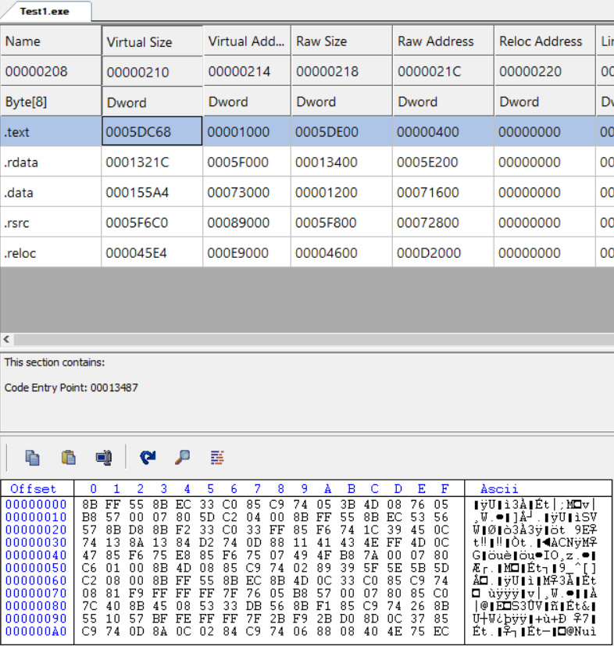
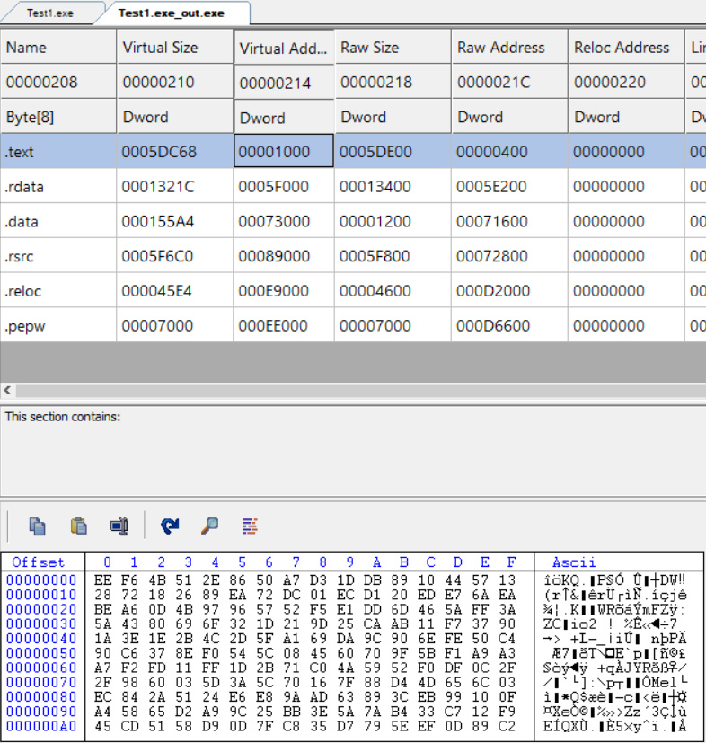
Implementation – Comparison

Slide 18
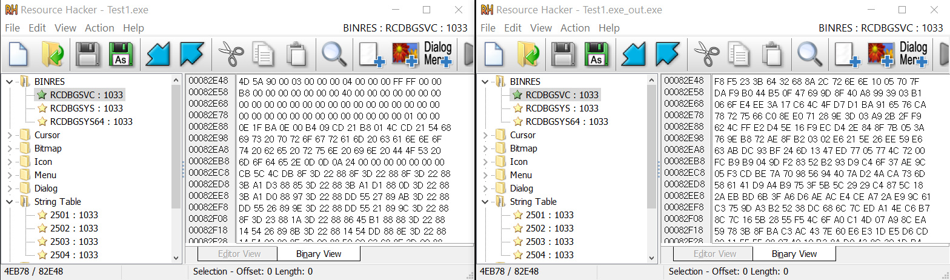
Implementation – Comparison

Slide 19
Conclusion

Slide 20
Conclusion
What I learned from this project | 1. How to deal with big and complex projects 2. How to make features more efficient in terms of the time complexity
What I regret the most during the project period | 1. Being lazy 2. The part where I couldn’t learn SEED128 ECB Algorithm more deeply due to the deadline
Future goals | 1. Releasing my library and this project on GitHub officially 2. Developing a better encryptor for software security using my library

Slide 21
Thank you

